Slide 1

Bienvenidos a la clase de espaÑol con la SeÑora GonzÁlez
Email: Tgonzalez@yonkerspublicschools.org

Slide 2
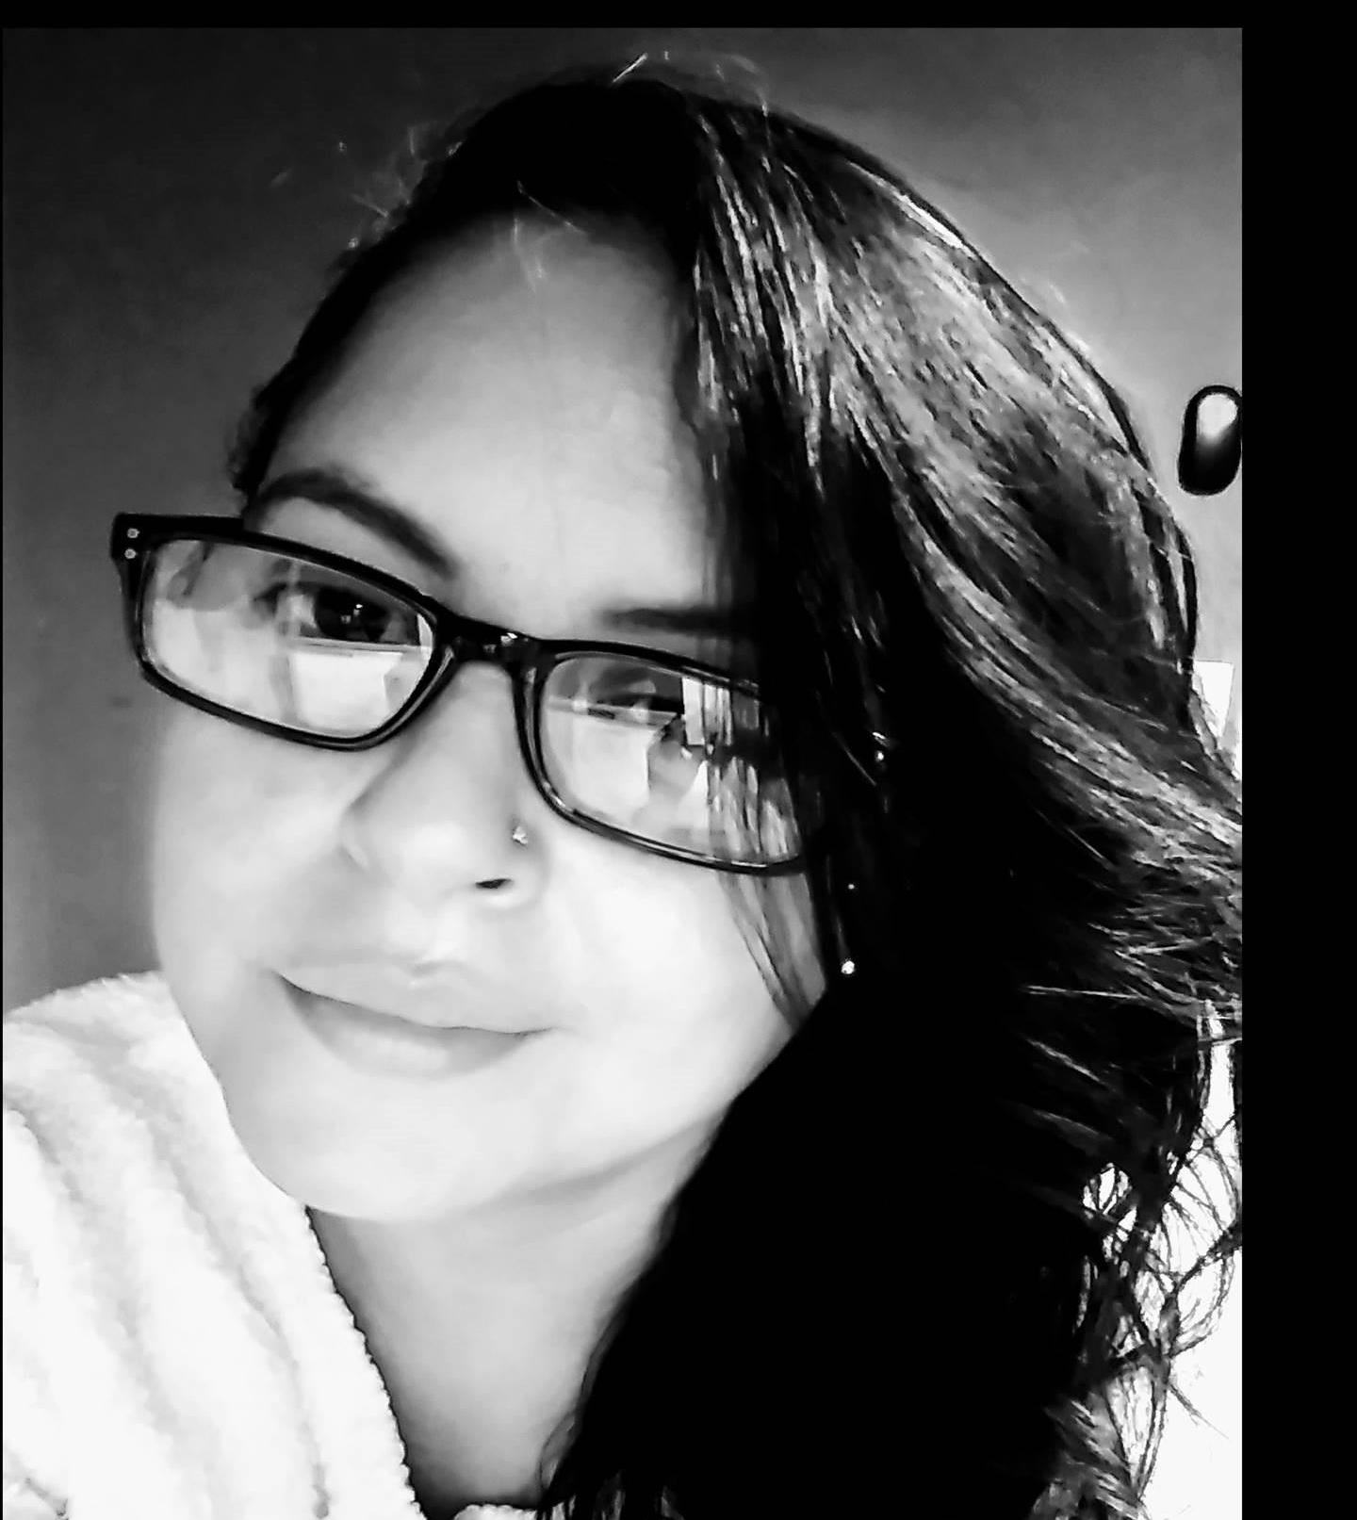
SeÑora GonzÁlez
Hola, me llamo Sra. González. I am one of the Spanish Teachers here at Saunders Trades & Technical High School. I have been teaching for 25 years. My expectations for this school year is to raise the cultural, literal and written ability of my students with regards to the Spanish language and the the Hispanic culture it is derived from.

Slide 3
Spanish 1 CPA-Check point
Topics covered:
Fourteen general topics will be covered during the course of the year.
Personal identification
House and Home
Family Life
Community/Neighborhood
Physical Environment
Meal taking
Health and Welfare
Education
Earning a Living
Leisure
Public and Private Services
Shopping
Travel
Current Events

Slide 4
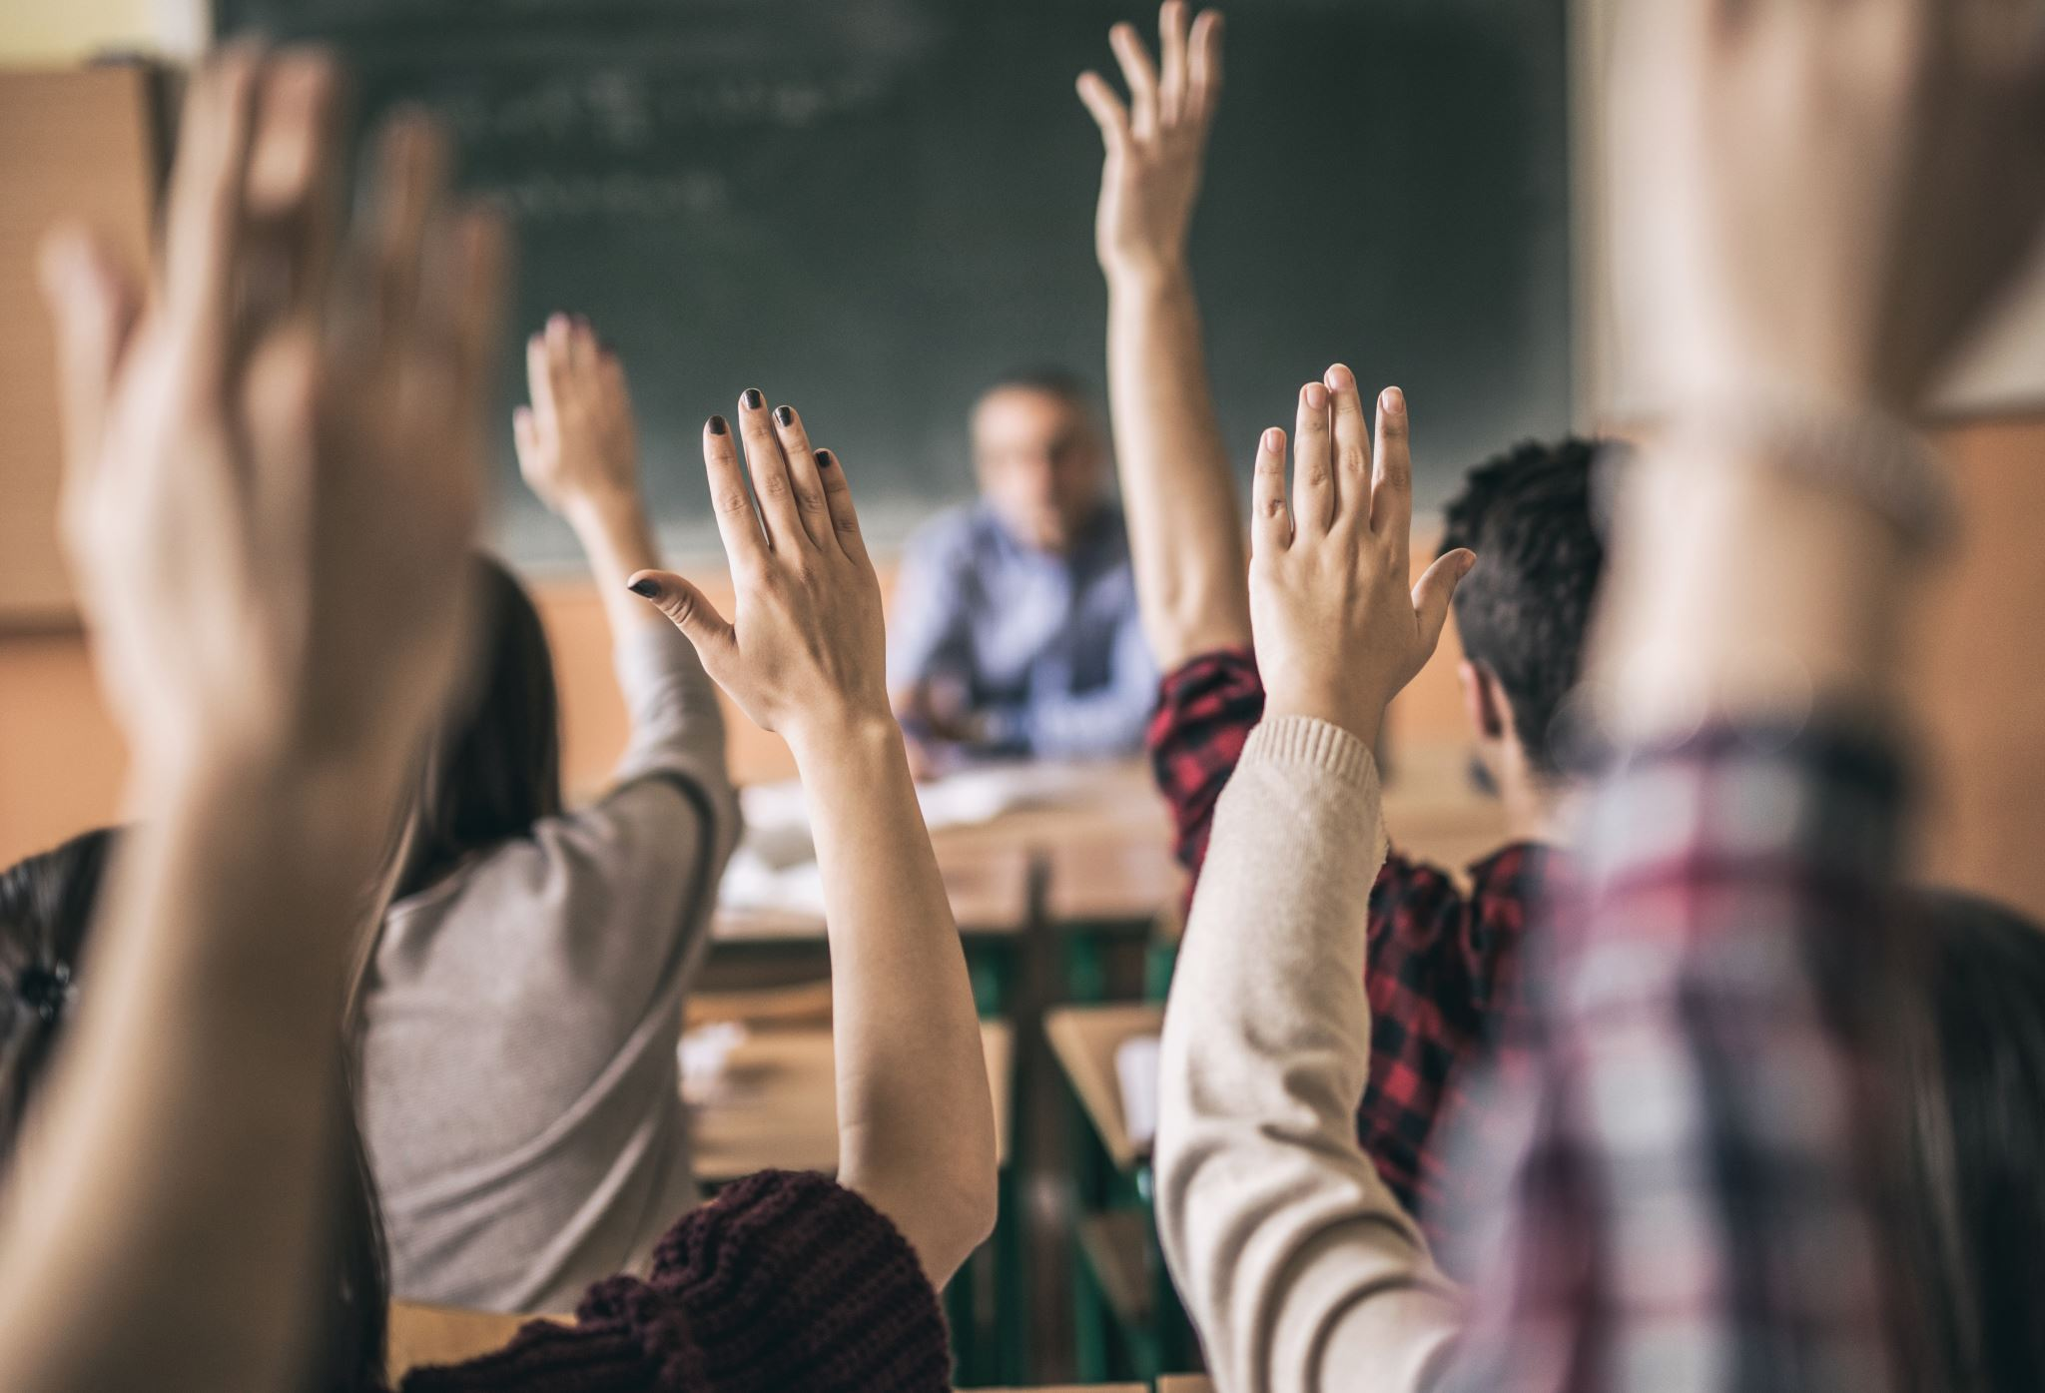
This course is designed to teach basic communication skills. Students will work towards developing the ability to speak, understand, read and write in the foreign language. Written, spoken, and visual presentations will help students to achieve functional communication while developing an understanding and an appreciation of a different culture.

Slide 5
Participation requires, verbal communication via responding and questioning on a regular basis.
Grading policy:
Classwork 45%
Homework 25%
Participation 20%
Test/Quiz 10%
All final grades are affected by excessive unexcused absences.

Slide 6
If a student has technical dificulties they are to notify me immediately via chat.
In order to complete assignments students are to look in the assignments file through Teams. All assignments are to be submitted via Teams. Students are not to submit work via my email. There is a "turned in" button students need to click on their behalf in order for work to show as submittted.

Slide 7
Students must take notes and write any translations relavant to the lesson.

Slide 8
Attendance is taken daily. Students must qualify in more than one way …
1- Sign on
2- Participate
3- View work
4- Log-on/off file

Slide 9
Active participation is required.
Students must respond when spoken to. If a student is spoken to twice and does not respond that equates to a zero.

Slide 10
Class requirements:
Be on time
Complete work
Participate
Respect one another
Mics muted
Raise your hand to be called on.

Slide 11

Students MAY TAKE HOME a book
Realidades book 1 this book is equivalent to the Autentico book used at times in class. It is alligned to the curriculum covered throughout the year.

Slide 12
¿Preguntas? Questions?

